Slide 1
CardioPredict
Cardiovascular Disease Risk Prediction System
Presented By:
Muhammad Kashir Khan Sp20-BSSE-008
Muhammad Daniyal Khan Sp20-BSSE-005

Slide 2
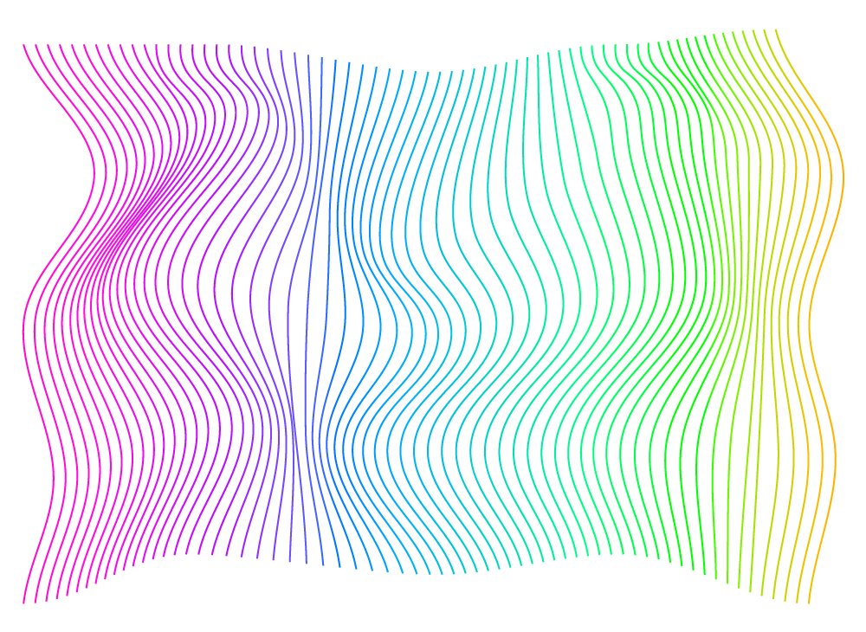
Why CardioPredict?
There are around 620 million people living with heart and circulatory diseases across the world
Cardiovascular diseases (CVDs) are the leading cause of death globally, taking an estimated 17.9 million lives each year.
It is important to detect cardiovascular disease as early as possible so that management with counselling and medicines can begin.
An estimated 17.9 million people died from CVDs in 2019, representing 32% of all global deaths. Of these deaths, 85% were due to heart attack and stroke.

Slide 3
INTRODUCTION
This Project addresses the pressing need for an effective CVD prediction system by employing three machine learning algorithms.
The primary objective is to develop a robust CVD risk prediction system, with a particular focus on assessing the feasibility of deploying a web application.

Slide 4
Dataset Overview
Number of Instances
The initial dataset contains data of 319,795 patients, which icreases after sampling.
Number of Attributes
There is 18 attributes in the dataset which reduce after Feature Engineering.
Nature of Data
The data mostly consists of categorical values. Some attributes also have continuous data.

Slide 5
Machine Learning Algorithms Used
01
04
02
03
06
Logistic Regression
Supervised Learning Algorithm, Works on Binary Classification
Decision Tree Classifier
Supervised Learning Algorithm, Works on Trees
Random Forest Classifier
Supervised Learning Algorithm, Works on ensemble technique

Slide 6
Methodological Course
The aside demonstration depicts the methodological course flow which has been persued in the aforementioned system.

Slide 7
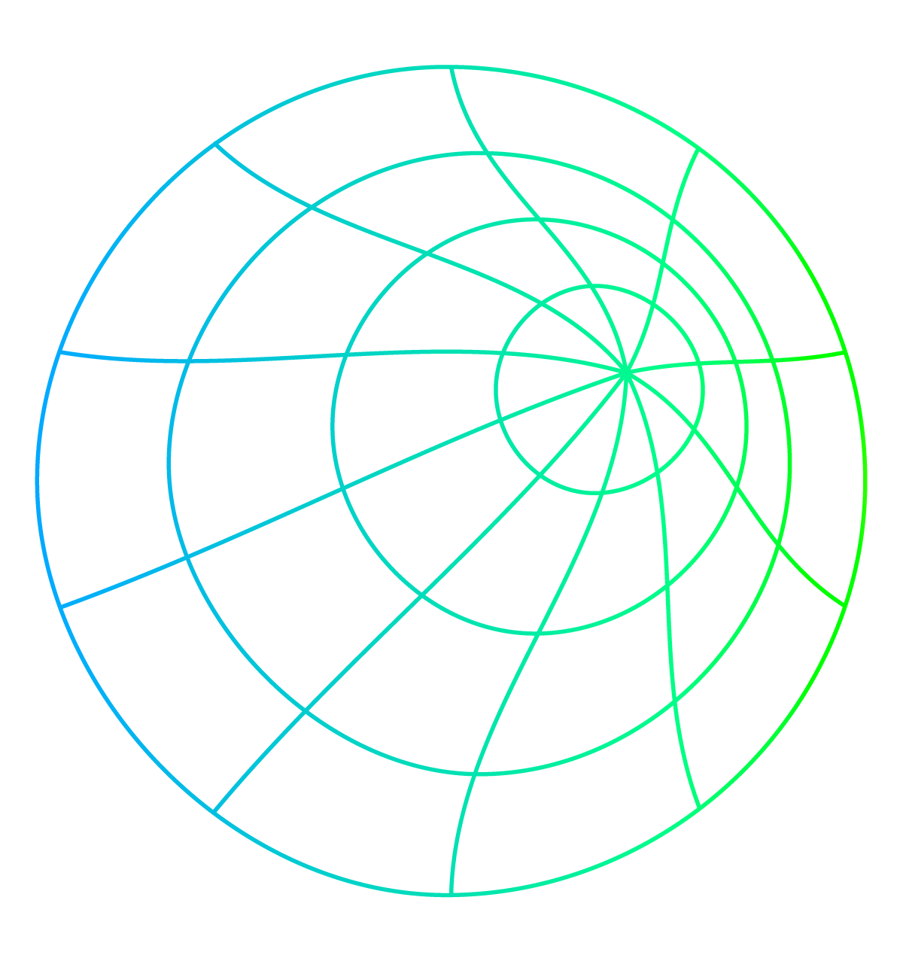
Data Preprocessing Techniques
Data Filtering
Data Deduplication
Class Imbalance
Data Encoding

Slide 8
Objectives and Goals
01
02
03
04
Precision in Risk Assessment
Accessibility and User-Friendly Interface
Empowerment through Data-Driven Insights
Utility for Healthcare Professionals

Slide 9
Functional Requirements
Machine Learning Models
Input Interface
ML models to predict the probability.
User Authentication
Entering clinical parameters to determine risk prediction.
User has to log in to access the system.

Slide 10
Non-Functional Requirements
Robustness
Maintainability
Performance
Usability
Reliability
Scalability
Compatibility

Slide 11
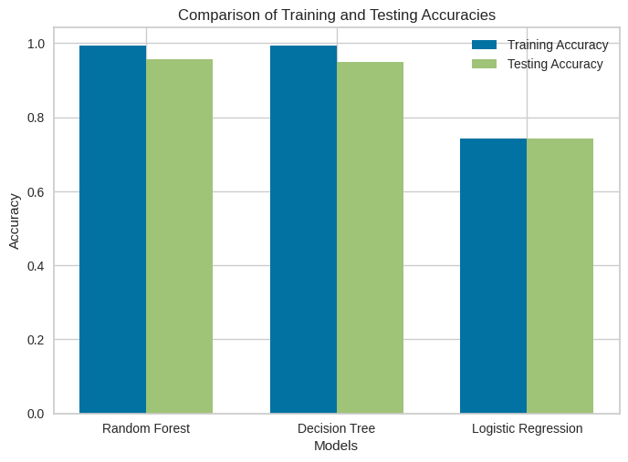
Accuracies Comparison
Upon comparing the models, the Random Forest model was observed as having the best testing & training accuracy amongst the three models used in this regard.

Slide 12
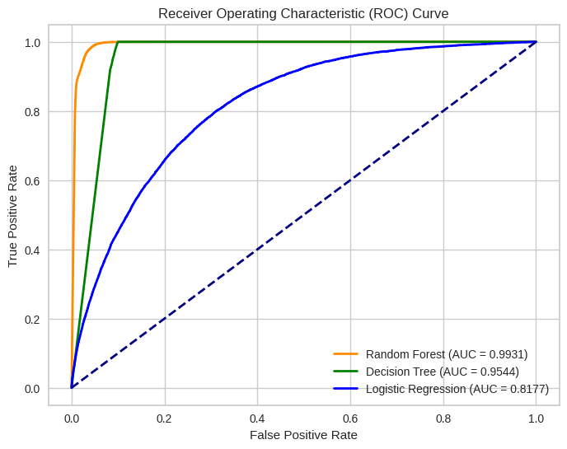
ROC Curves
ROC curves are developed to evaluate the performance of classification models on thresholds. In this figure, Random Forest comes out to be the best in terms of performance.

Slide 13
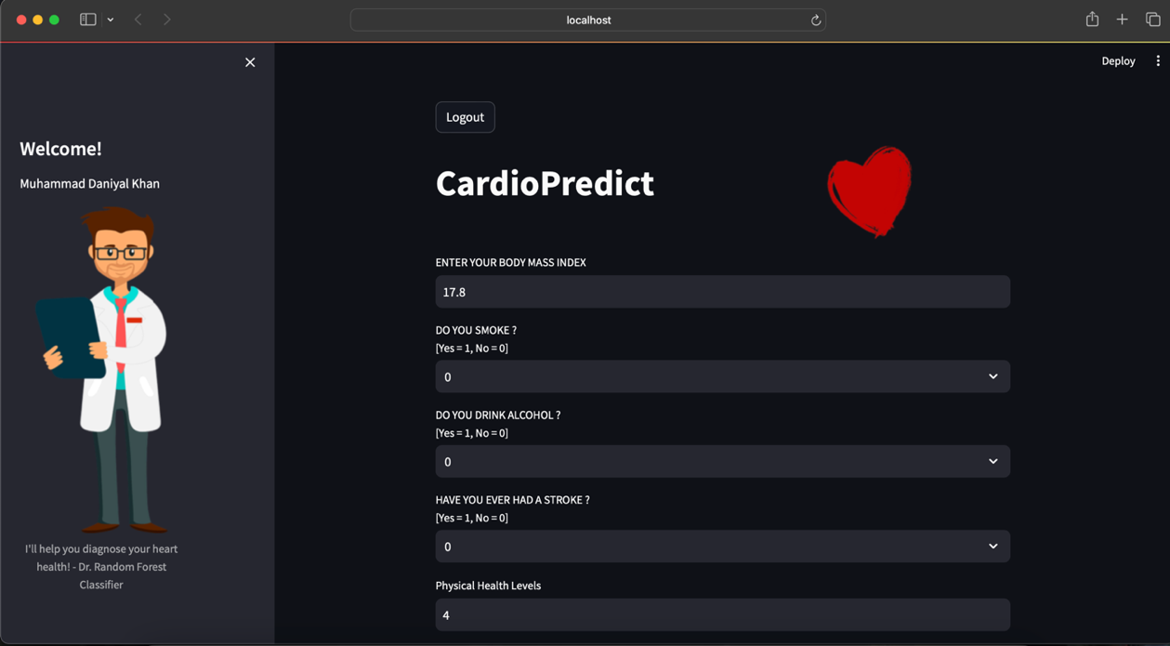
User Interface
Finally, Random Forest classifier was used to deploy a user interface in the Streamlit environment.

Slide 14


